Slide 1
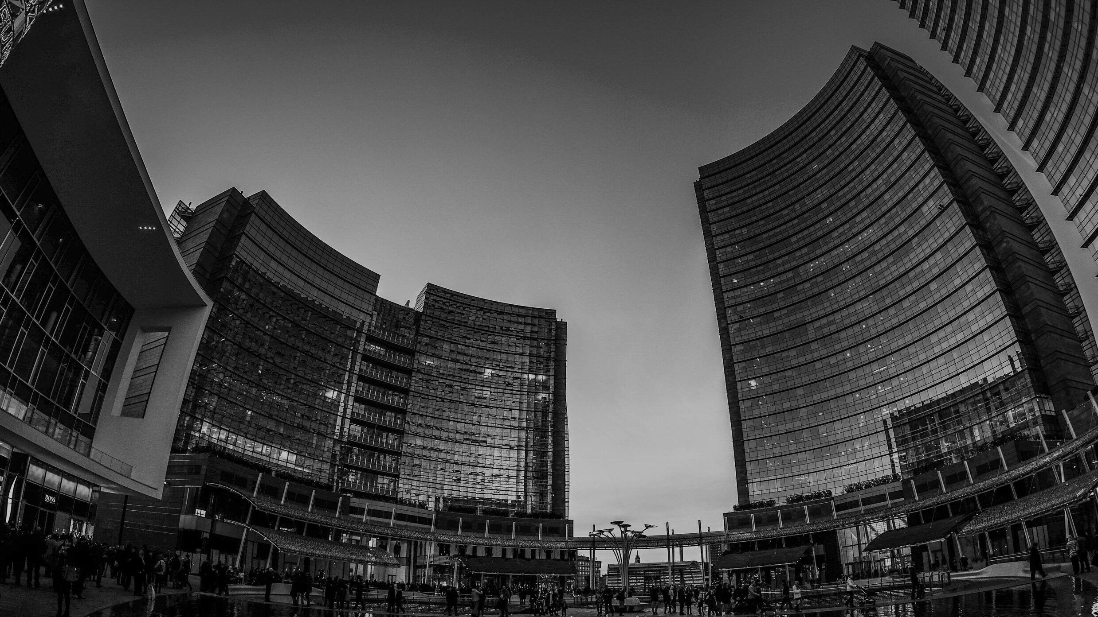

CINEMA TICKET BOOKING
SYSTEM
Guided By
Prof .Rajalakshmi . S

Slide 2
TEAM MEMBERS
E6220001 HIMASHREE . P
E6220002 GOWTHAMI . A
E6220003 S RUTHIKA . S
E6220005 RAJ ALAKSHM I . B
E6220008 ROHAYA FATHIMA . S
BSc .DATA SCIENCE

Slide 3
AGENDA
01
INTRODUCTION
04
OUTPUT
02
PROBLEM STATEMENT
05
CONCLUSION
03
WORK FLOW

Slide 4

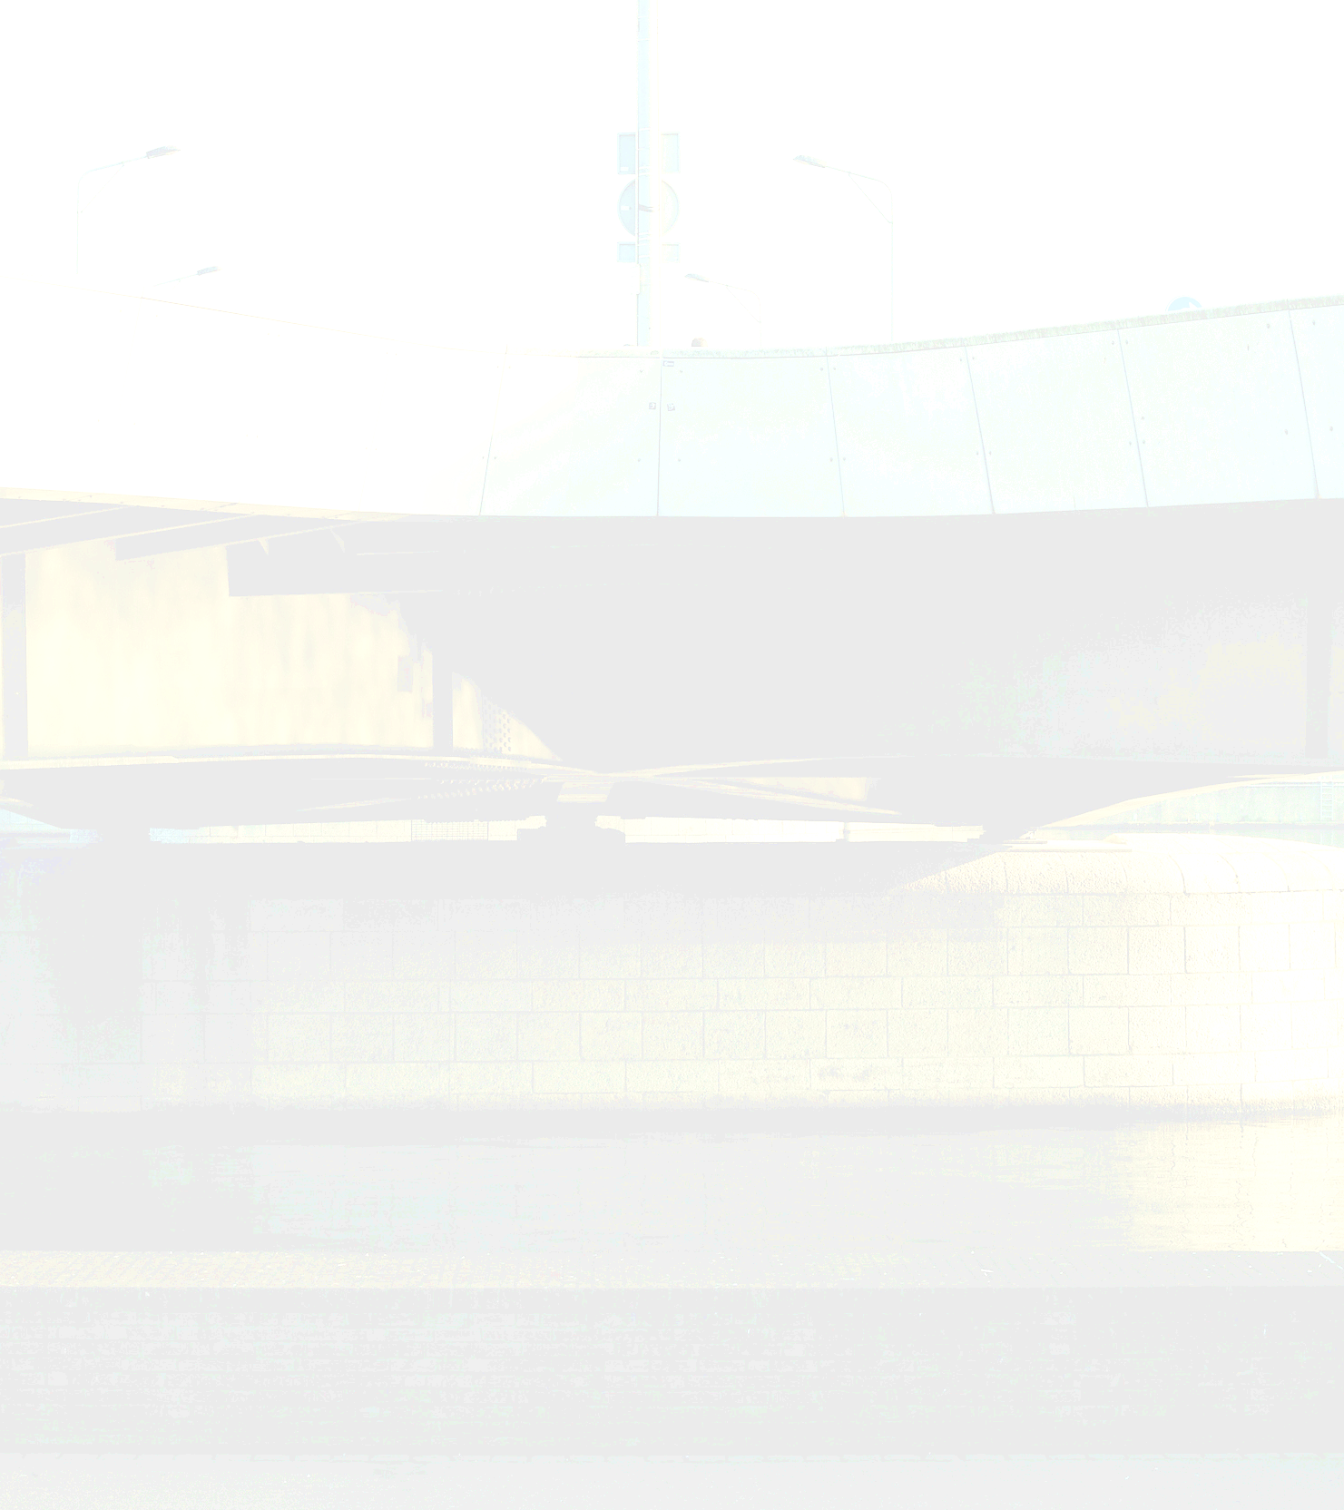
Online Movie Ticket Booking System done using JSP in Eclipse environment is a dynamic web application where users can make use of the application in the browser to view the movies list and book tickets accordingly. Details such as the login information and the user’s last website accessed time is stored in the backend using MySQL database.
INTRODUCTION

Slide 5


The main focus of the project is to create a cinema ticket booking system using JSP for website development and MySQL database for backend connection which stores the user ‘s login info and several other details with an ultimate aim of making the website a user friendly one.
PROBLEM
STATEMENT

Slide 6

Cinema Ticket Booking System
WORK FLOW
Sign Up
Login
Booking Successful
Home
Select Show Time
Ticket Summary
Payment

Slide 7
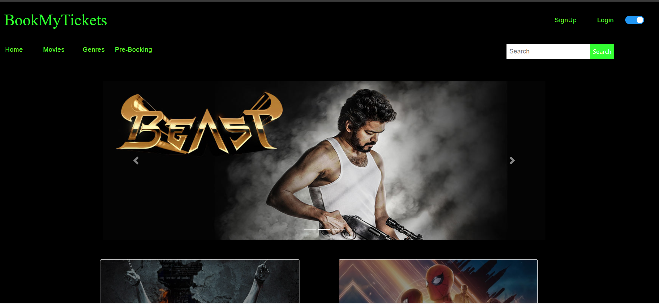
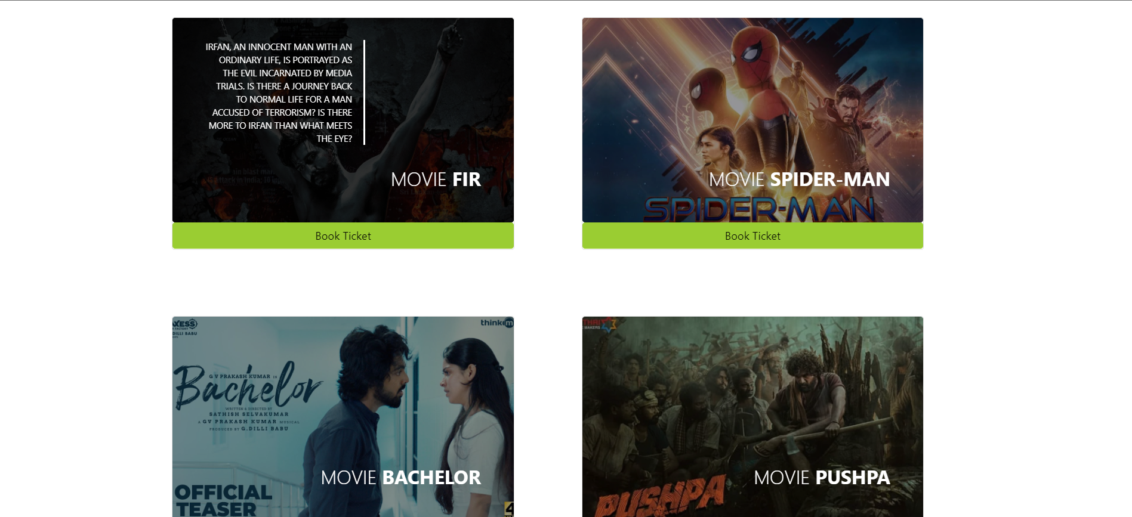
HOME PAGE

Slide 8
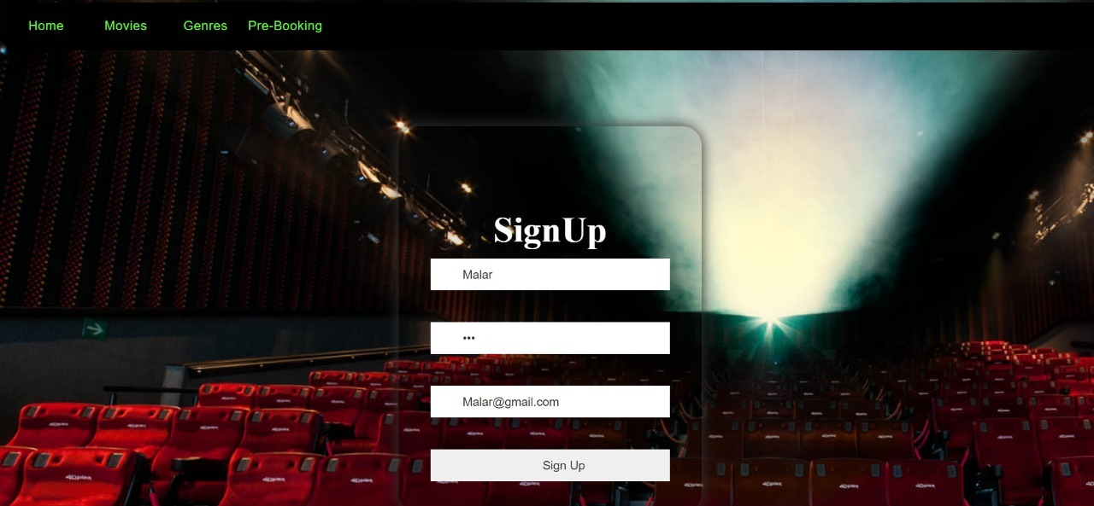
SIGN
SIGNUP PAGE
Sign Up Page is to be clicked if the user hasn’t signed up earlier or if the data is not present in the database.

Slide 9
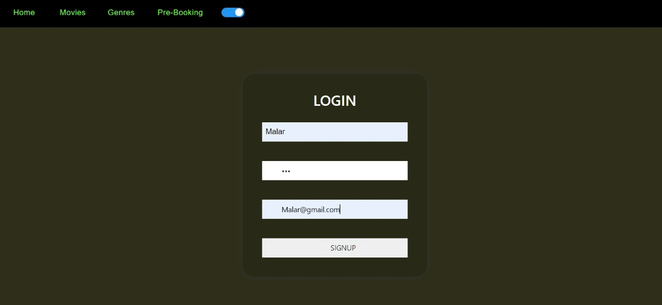
LOGIN PAGE
If the login is success, the page redirects to the Home page else to the SignUp page

Slide 10
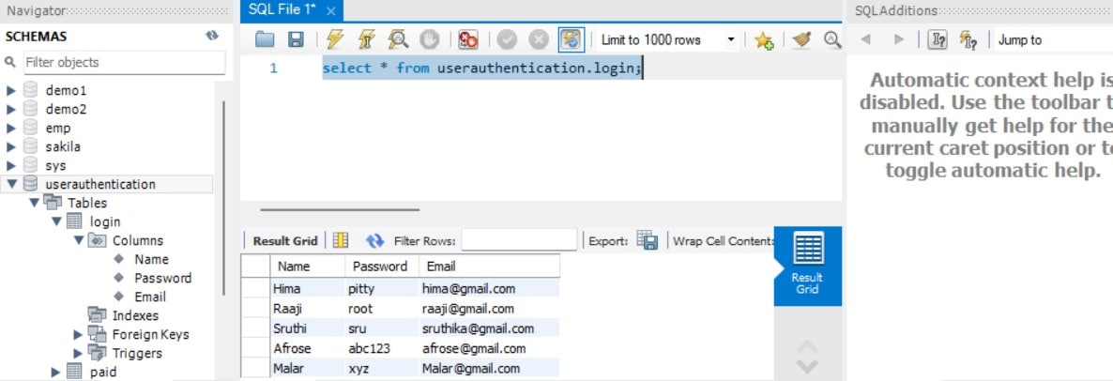
LOGIN DETAILS DATABASE

Slide 11
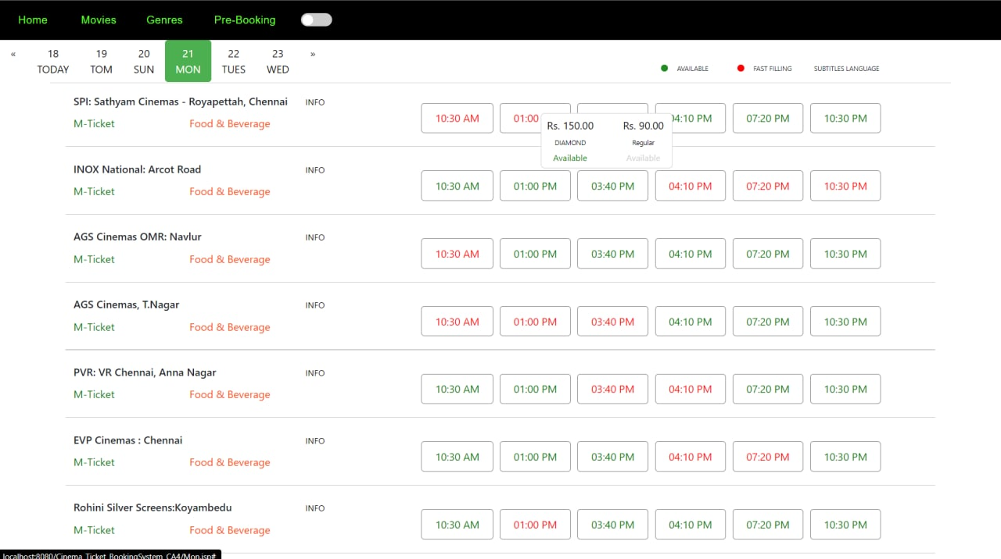
BOOK TICKETS page

Slide 12
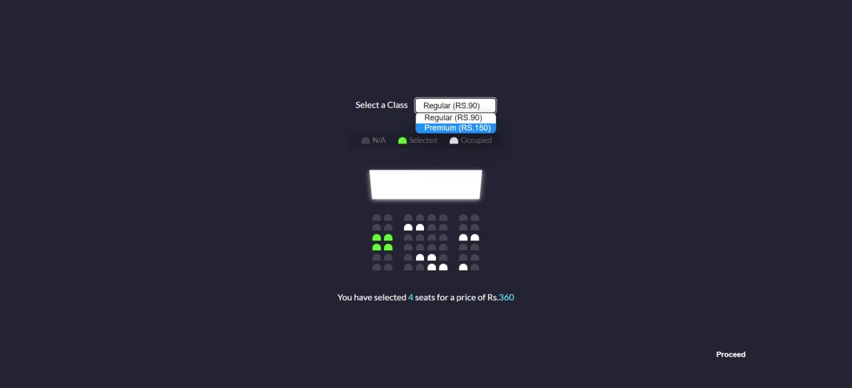
SEAT AVAILABILITY PAGE

Slide 13
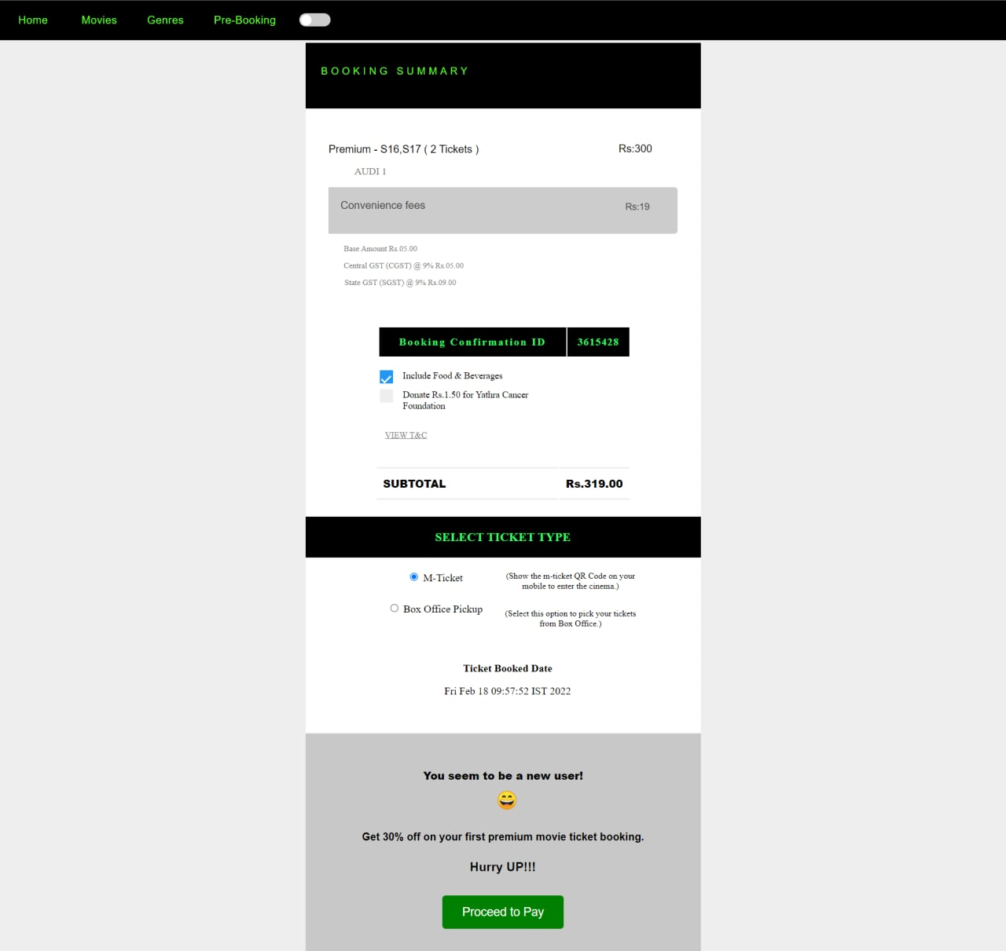
BOOKING SUMMARY PAGE

Slide 14
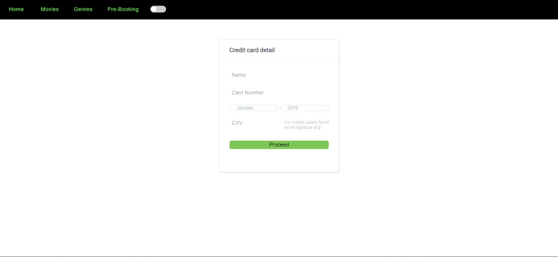
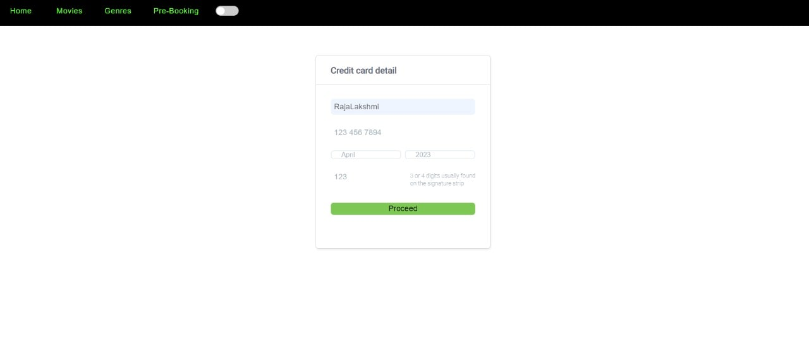
PAYMENT PAGE
Once the user enters his/her payment details, their names along with the current payment date is stored in the database.

Slide 15
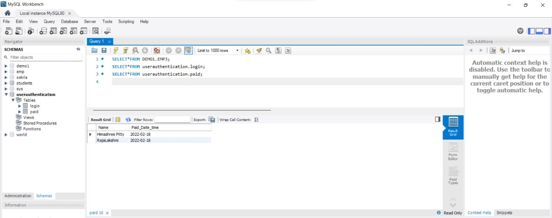
PAYMENT details database

Slide 16
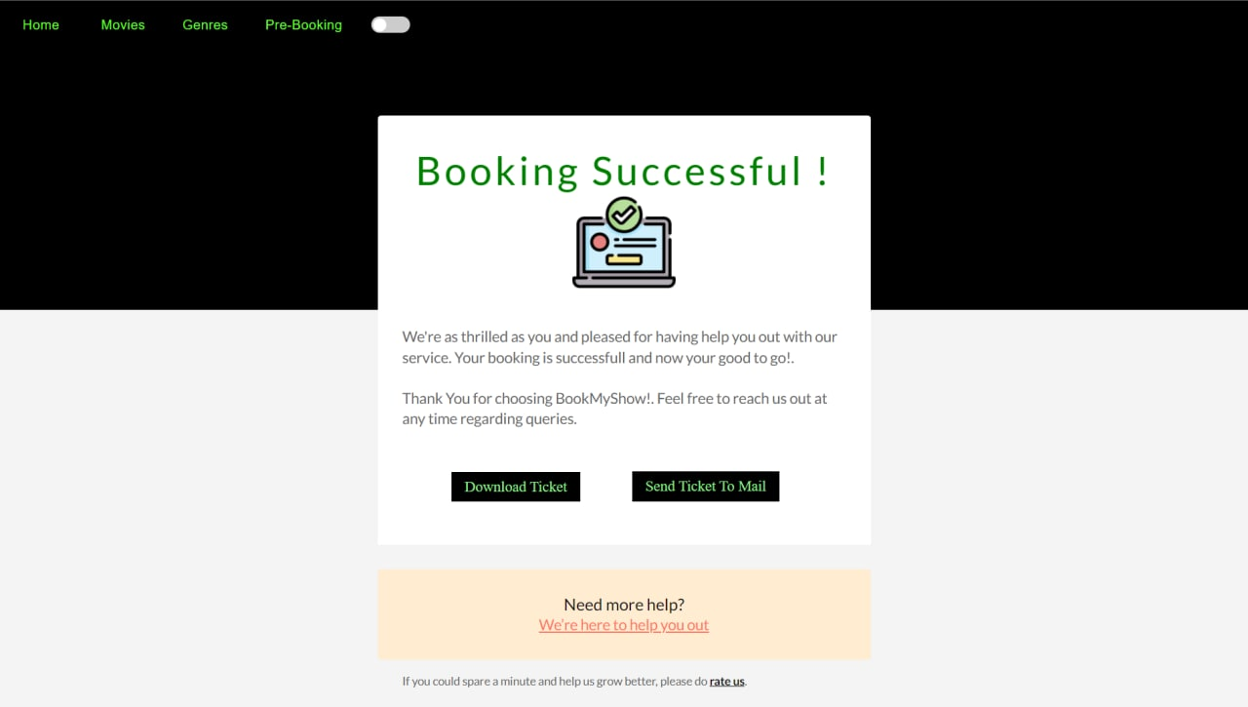
BOOKING SUCCESSFUL

Slide 17
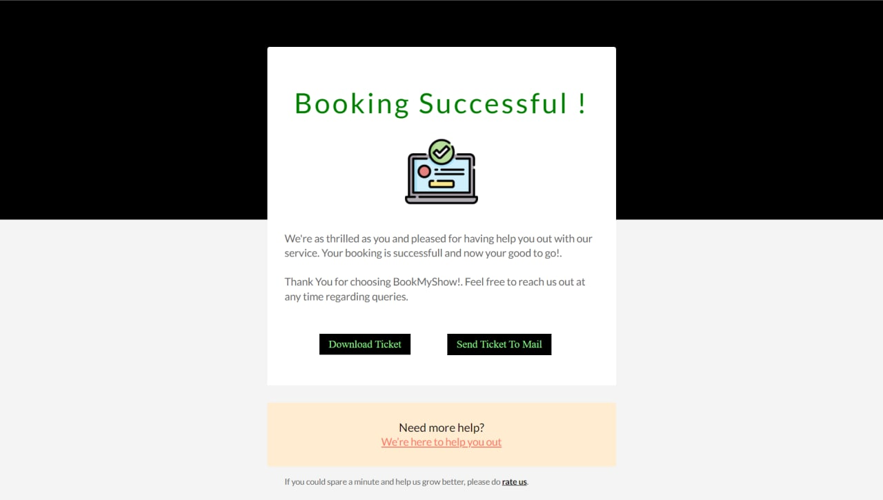
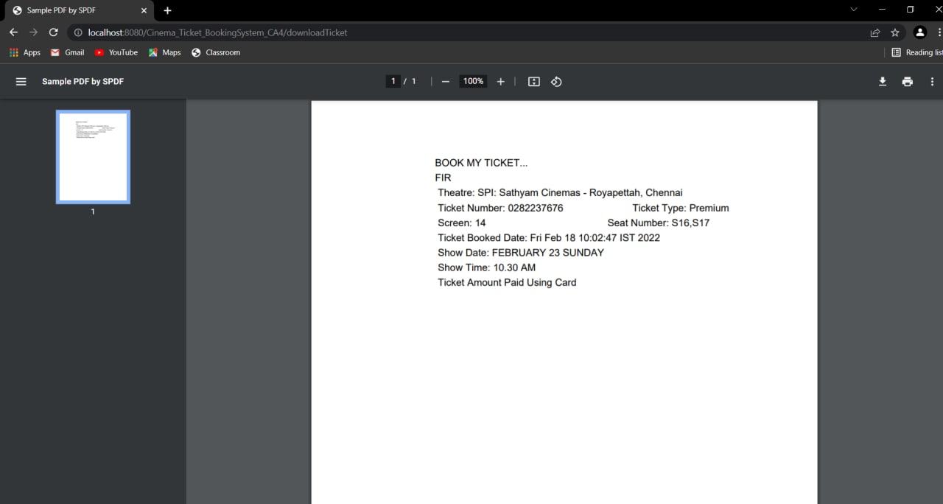
DOWNLOAD TICKET
Ticket.pdf

Slide 18
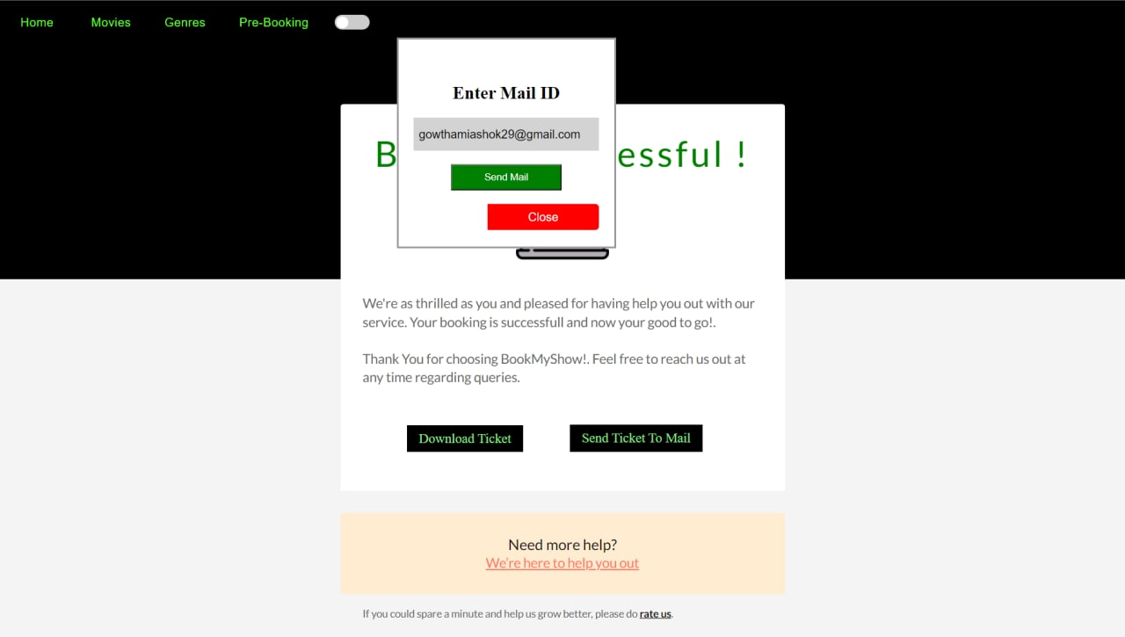
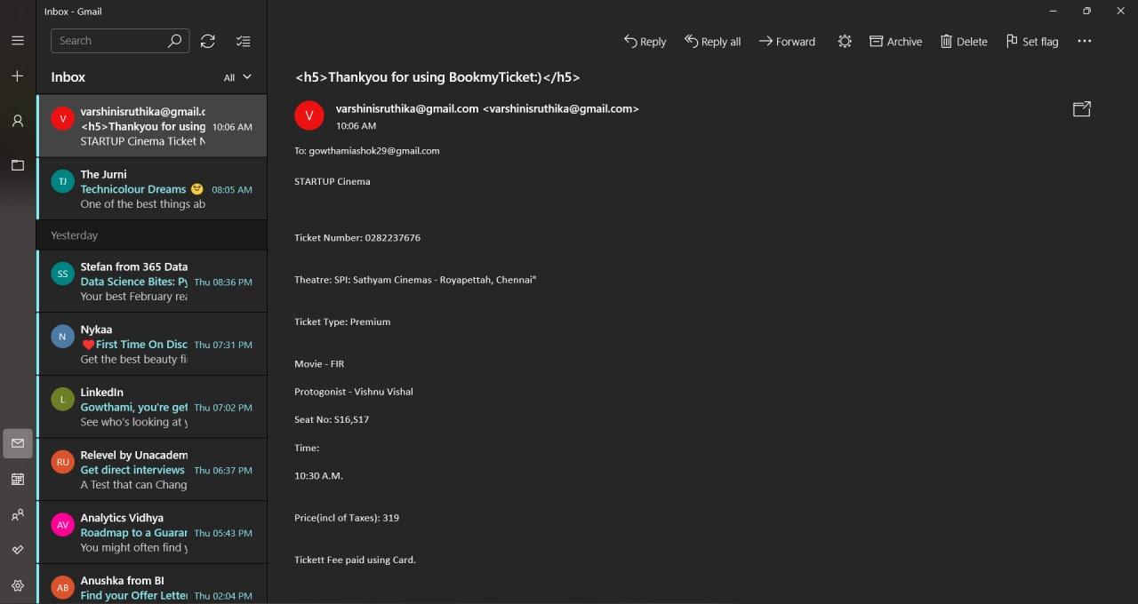
SEND TICKET TO MAIL
MAIL

Slide 19
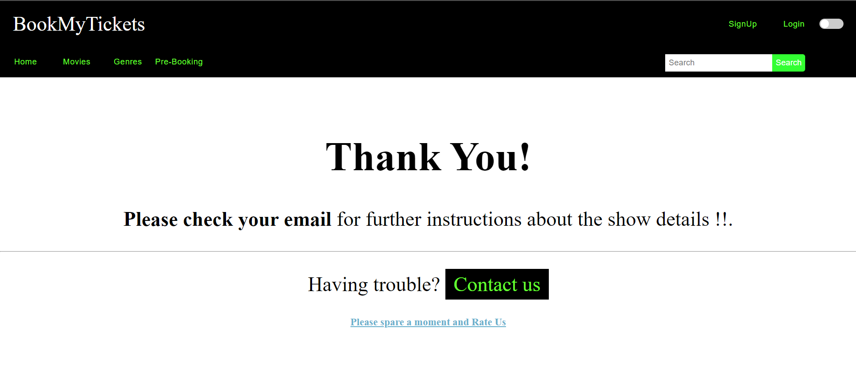
THANK YOU

Slide 20

We are in the new era of life where technology dominates human life. People prefer easy, quick and safe way in every part of their lives . So, the traditional reservation ways of booking movie ticket are quite tedious to use and outdated .This project is designed to meet the requirements of a user friendly Cinema Ticket Booking System thereby helping to satisfy the needs of their customers.
CONCLUSION

Slide 21
https://getbootstrap.com/docs/5.1/getting-started/introduction/
REFERENCES
https://www.w3schools.com/css/css_rwd_templates.asp
https://getbootstrap.com/docs/5.1/getting-started/introduction/
https://fontawesome.com/start
https://in.bookmyshow.com/explore/movies

Slide 22
THANK YOU...

